Slide 1
Stock Price Forecasting Using Data From Yahoo
Finance and Analysing Seasonal and Nonseasonal
Trend
DSCI560
Instructor：Young Cho, Ph.D.
Yifan Yang
8386626867

Slide 2
INTRODUCTION and LITERATURE REVIEW and VARIATION IN TRENDS
Highlights from what I read：
1. These issues generally increase the dependency of stock price prediction on them rather than focusing primarily on the actual prices of stocks. Therefore, Time series analysis is the most optimal solution to the problem.
2. Time series analysis eliminates the dependence of one factor on another in forecasting. Various techniques for time series analysis to predict stock prices.
3. time series and proposed the idea of decomposition model. Currently, some methods have been developed to analyze seasonal time. But I think the review of this paper is extremely imperfect. First of all, the papers cited are very old, and secondly, the number and research cited are insufficient.
4. There are several reasons behind seasonal trends, which is why the paper analyzes them in this way. Inventory funding attempted to improve towards the end of the year, causing stock prices to rise. Another reason may be part of the year-end bond coupon payments flowing into the stock market
SECTION TITLE | 2
SECTION TITLE | 2

Slide 3
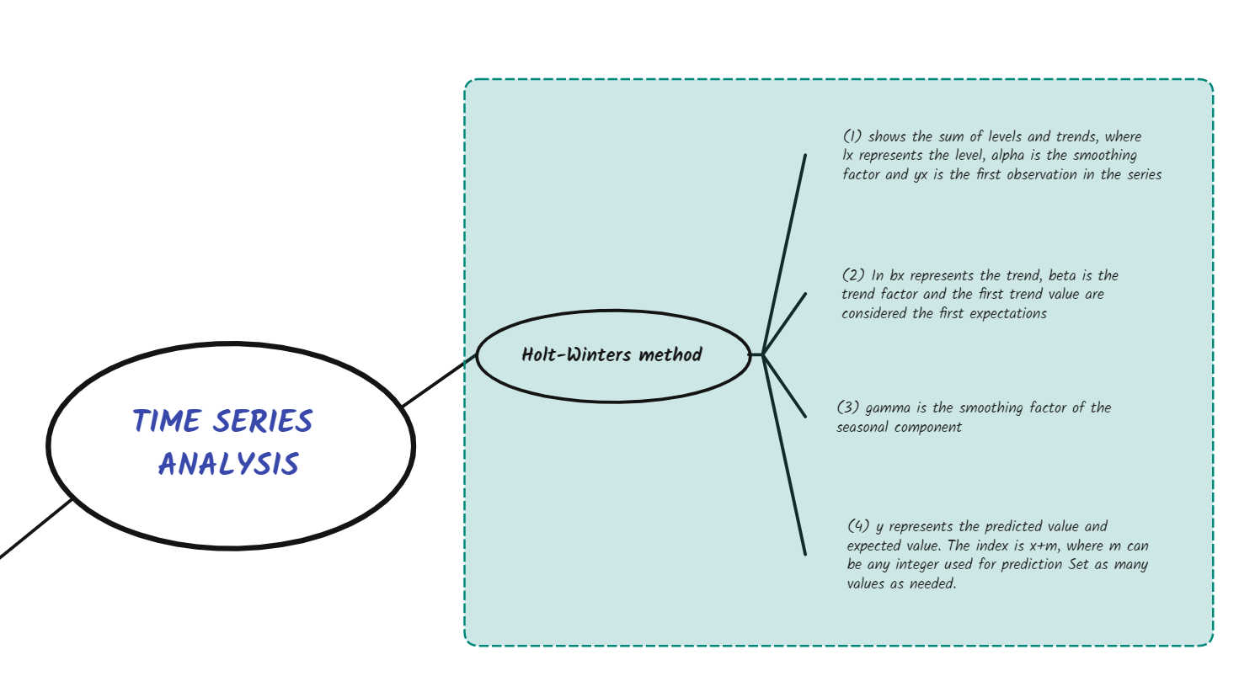
TIME SERIES ANALYSIS

Slide 4
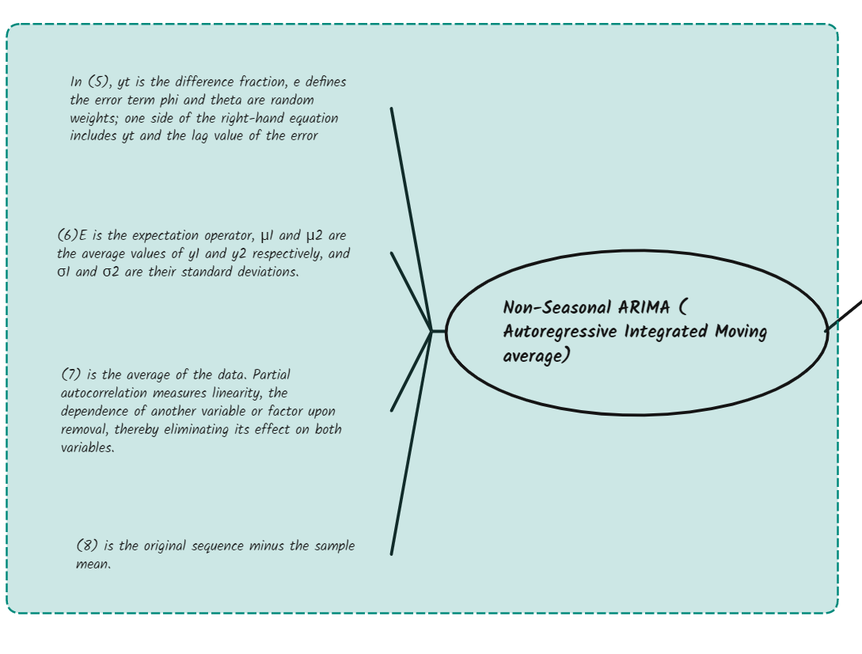
TIME SERIES ANALYSIS

Slide 5
PROPOSED WORK and WORKING
Highlights from what I read：
1. This article proposes to apply two different forecasting methods Holt Winter Exponential Smoothing and ARIMA (Autoregressive Integrated Moving Average)
2. To capture seasonal trends in the data, the Holt-Winters method needs to be applied to the actual trend and its triple exponential smoothing. Since the above does not take into account the non-seasonal trend of stock prices, the trend of price behavior is disturbed when the ARIMA model is applied to actually study the seasonality of the data.
3. If the results of both are the same, a better output can be extracted Holt-Winter method and ARIMA method are combined to find the price range that investors can bear to make profit. Therefore, we combine the outputs of the two curves to find the range of stock prices.

Slide 6
RESULTS & OBSERVATIONS and CONCLUSION
Highlights from what I read：
This article briefly describes two different combined time series analysis models to find precise results. Both models are inherently simple and because these predictions are based purely on history.
This experiment has some limitations and shortcomings because other factors were never considered in this work. Personally, I think this paper is just a good beginning, and there is still a lot of specific work to be done.
Q1: This article proposes the application of two different forecasting methods, Holt Winter exponential smoothing and ARIMA, what are the benefits of such a combination?
A1: These two methods have different strengths when processing time series data. The Holt-Winters method is good at handling seasonal changes, while ARIMA is better at capturing trends and non-seasonal patterns in the data. Combining them provides a more comprehensive and accurate forecast.

